Slide 1

COMPUTER NETWORKS
(BCSC 0008)
Copyright content, use only with the written permission of presenter mentioned
Lecture 21

Slide 2
Text and Reference Books
Text Books:
Fourouzan B. A. (2004), “Data Communication and Networking”, 4th Edition, McGraw-Hill.
References:
Kurose, J. F. and Ross K. W. (2005), “Computer Networking: A Top-Down Approach Featuring the Internet”, 3rd Edition, Addison-Wesley.
A. S. Tanenbaum (2006), “Computer Networks”, 2nd Edition, Prentice Hall India.

Slide 3
14.4 LINK STATE ROUTING
In link state routing, if each node in the domain has the entire topology of the domain, the node can use Dijkstra’s algorithm to build a routing table.
The topics discussed in this section include:
Building Routing Tables

Slide 4
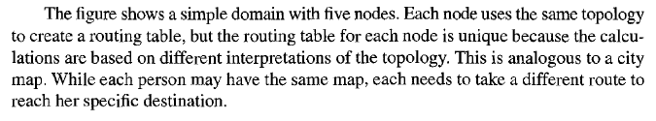
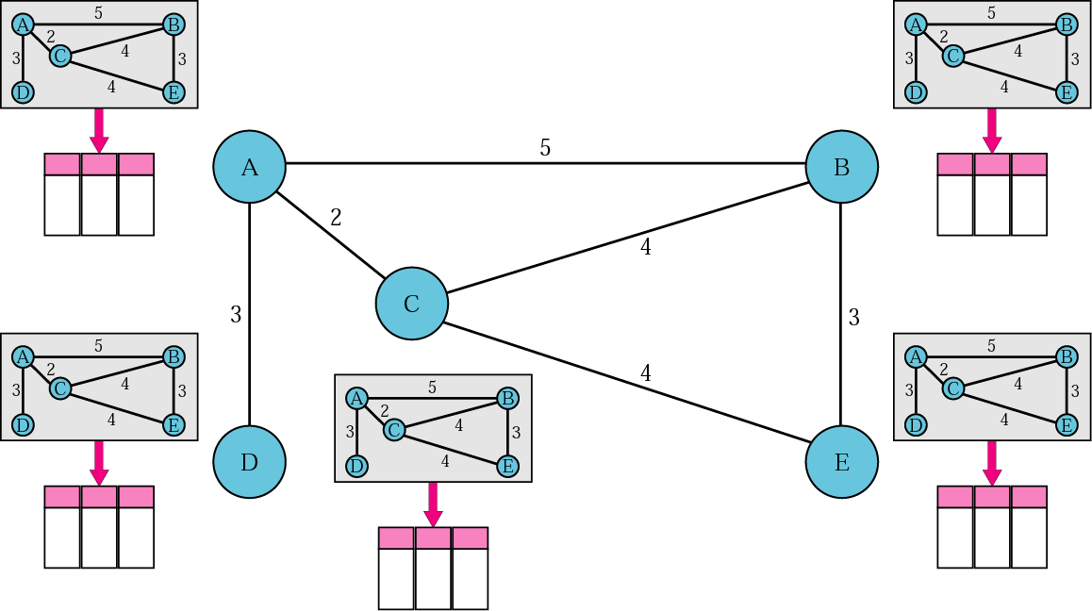
Figure 14.15 Concept of link state routing
Every router has knowledge about the network, but from its own perspective.

Slide 5
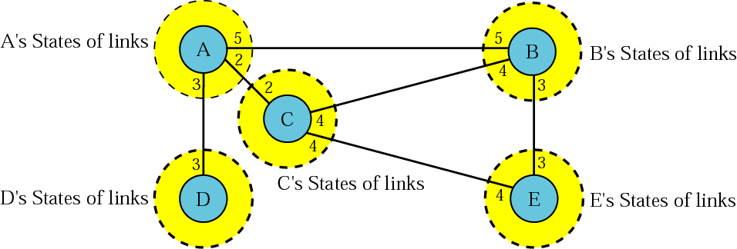
Figure 14.16 Link state knowledge
Each router knows (maintains) its states of its links.
Each router floods this info (via a Link State Packet) to other
routers periodically (when there is a change in the topology,
or every 60 to 120 minutes).
Each router takes in this data and, using Dijkstra’s
algorithm, creates the shortest path tree and corresponding
routing table.

Slide 6
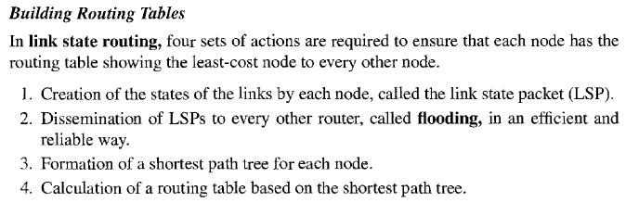
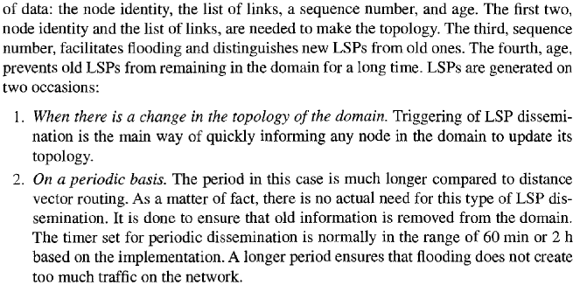

Slide 7
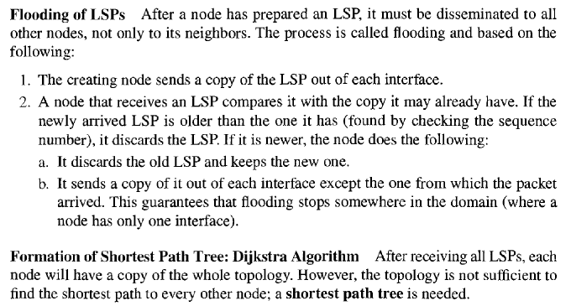

Slide 8
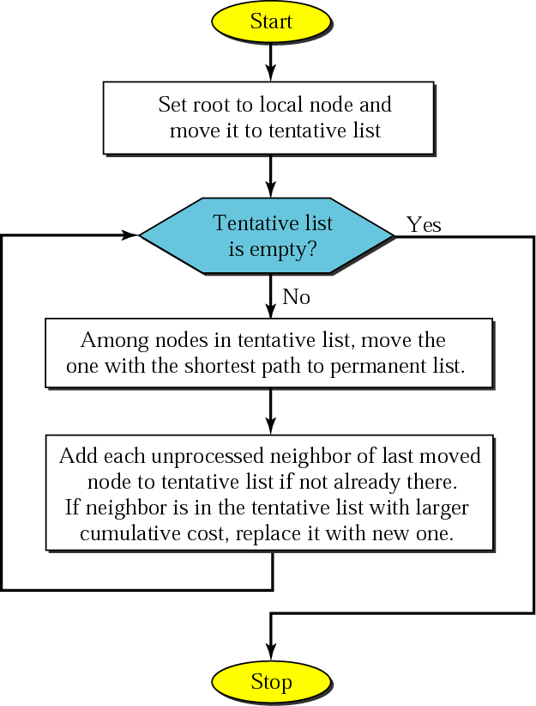
Figure 14.17 Dijkstra algorithm

Slide 9
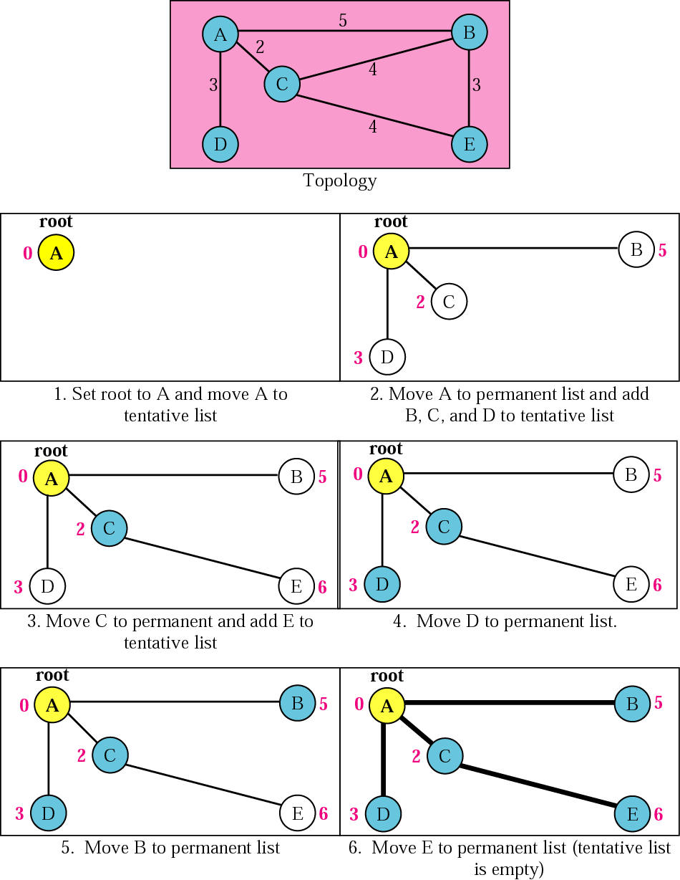
Figure 14.18 Example of formation of shortest path tree

Slide 10
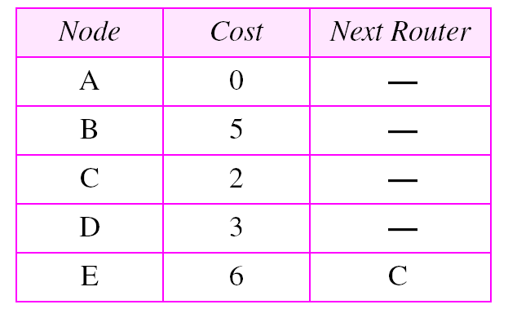
Table 14.1 Routing table for node A
Now let’s try using the Dijkstra’s algorithm introduced in
TDC 361.

Slide 11
